Slide 1
CNNs

Slide 2
Specialized kind of neural network for processing data that has a known, grid-like topology.
Examples include
time-series data, which can be thought of as a 1D grid taking samples at regular time intervals,
and image data, which can be thought of as a 2D grid of pixels.
Convolutional networks are simply neural networks that use convolution in place of general matrix multiplication in at least one of their layers.

Slide 3
Replace matrix multiplication in neural nets with convolution
Everything else stays the same
Maximum likelihood
Back-propagation
etc.

Slide 4
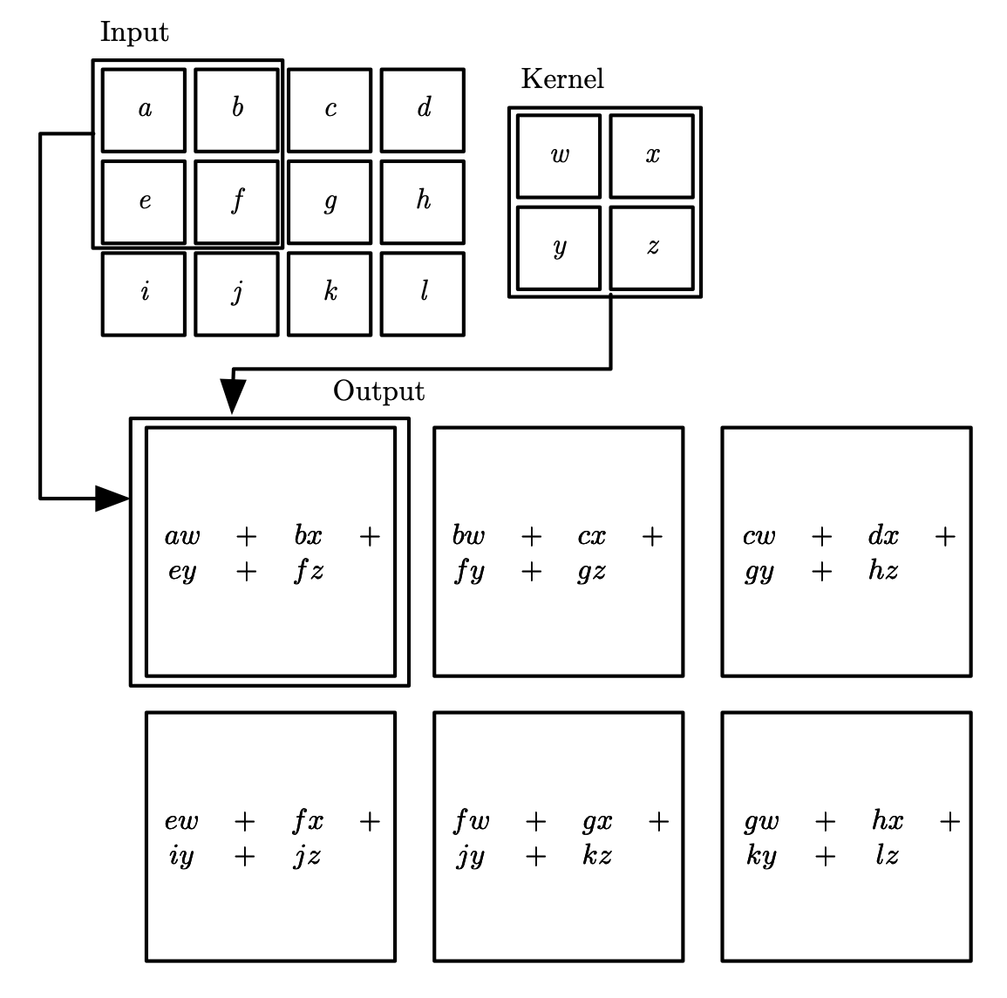

Slide 5
Scale up neural networks to process very large images / video sequences
Sparse connections
The kernel is smaller than the input: 𝑂(𝑚×𝑛)→𝑂(𝑘×𝑛)
Parameter sharing
The kernel is used at every position of the input
Equivariant representations
Automatically generalize across spatial translations of inputs
𝑓 is equivariant to 𝑔 if 𝑓(𝑔(𝑥))=𝑔(𝑓(𝑥))
Works with inputs of variable size
Applicable to any input that is laid out on a grid (1-D, 2-D, 3-D, …)

Slide 6
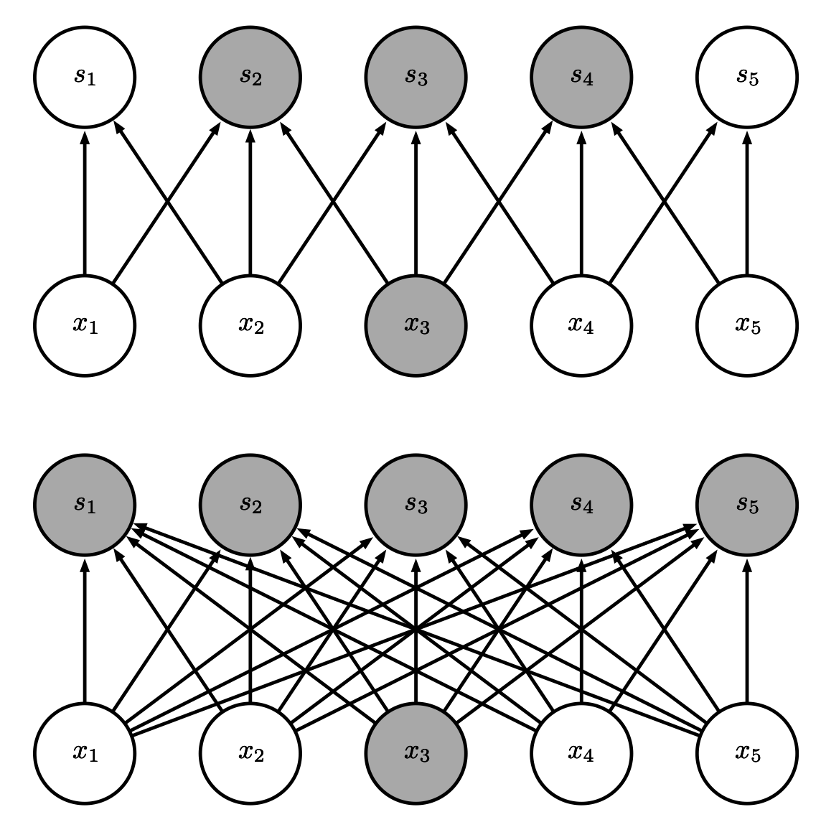
Sparse Connectivity (viewed from below)
Sparse
connections
due to small
convolution
kernel
Dense
connections

Slide 7
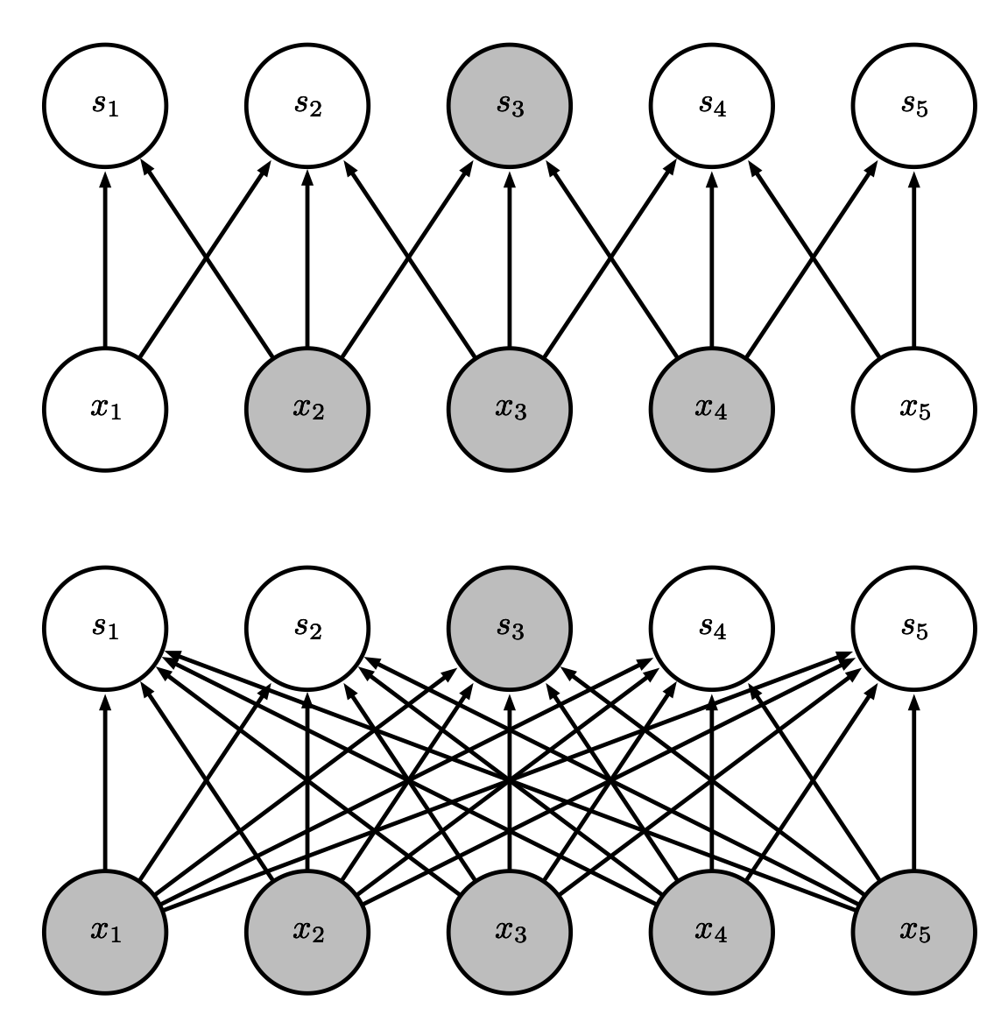
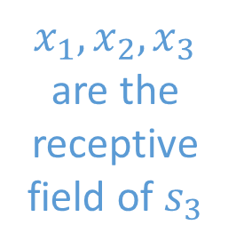
Sparse Connectivity (viewed from above)
$x_{1}, x_{2},x_{3}$ are the receptive field of $s_{3}$
Sparse
connections
due to small
convolution
kernel
Dense
connections

Slide 8
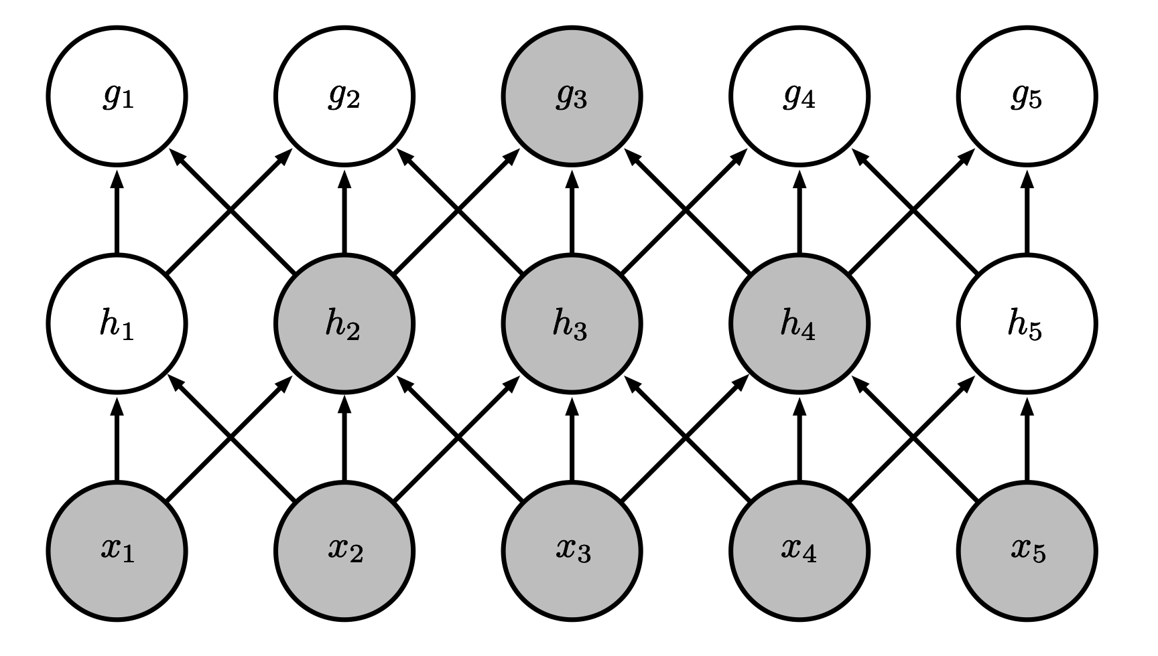
Growing Receptive Fields
Even though direct connections in a convolutional net are very sparse, units in the deeper layers can be indirectly connected to all or most of the xinput image.

Slide 9
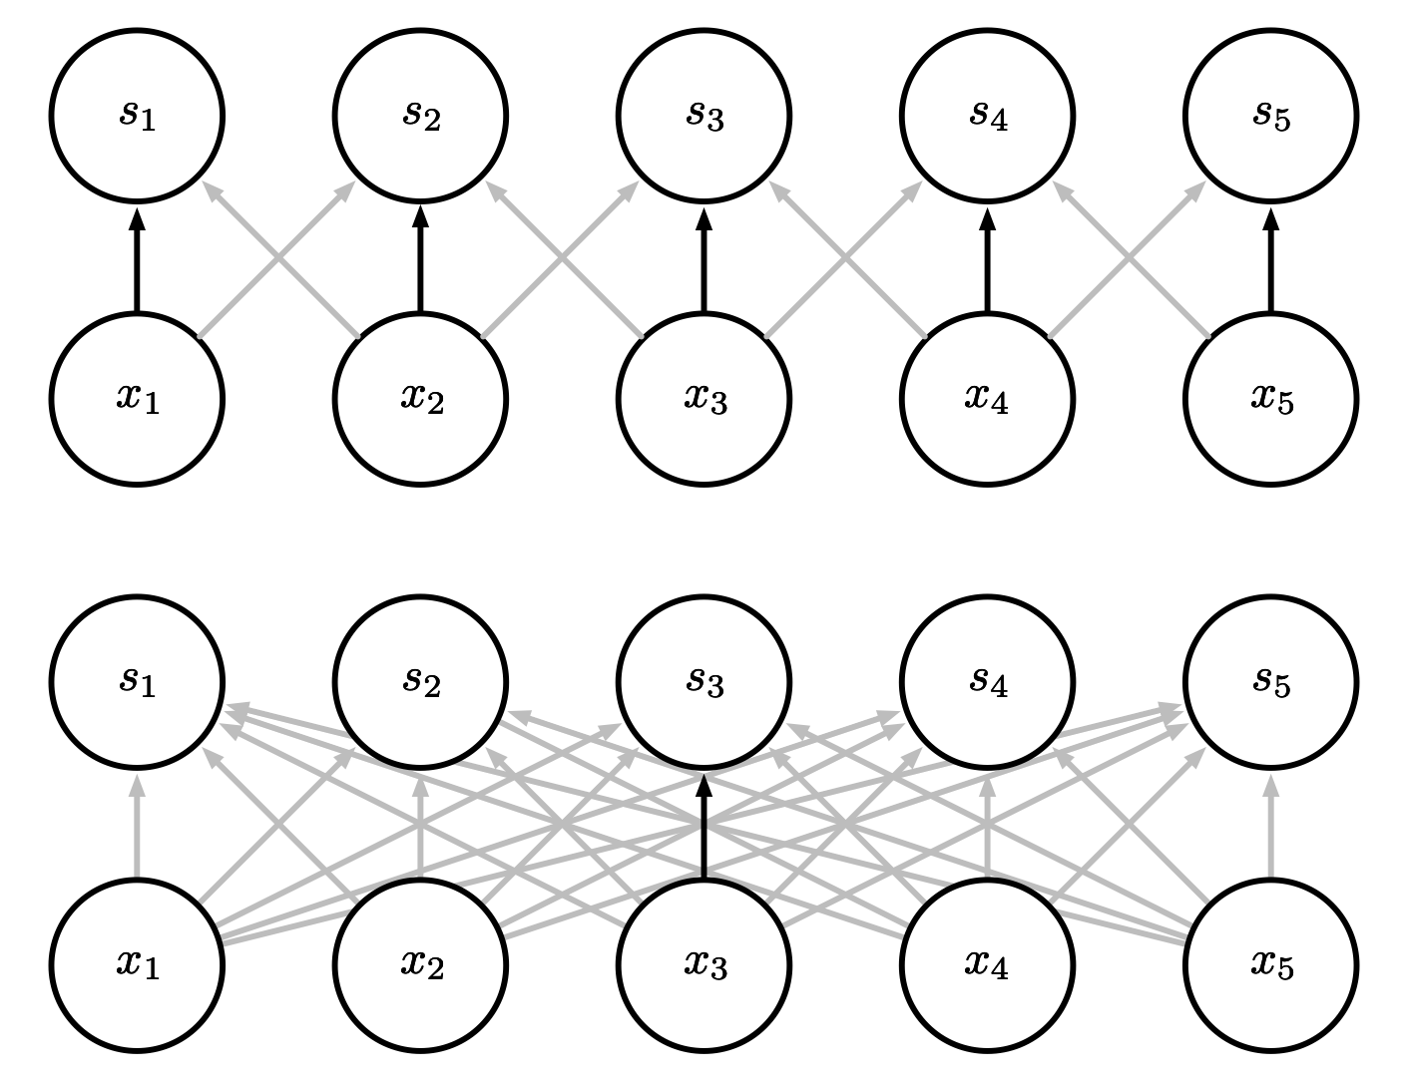
Parameter Sharing
Convolution shares the same parameters across all spatial locations
Traditional matrix multiplication does not share any parameters

Slide 10
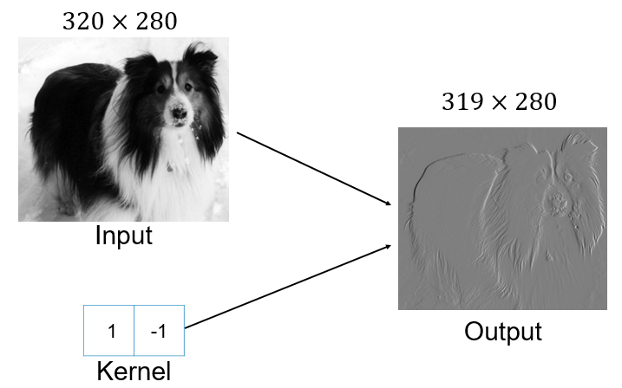
Edge Detection by Convolution

Slide 11
To say a function is equivariant means that if the input changes, the output changes in the same way.
Specifically, a function f(x) is equivariant to a function g if f (g(x)) = g(f(x)).
In the case of convolution, if we let g be any function that translates the input, i.e., shifts it, then the convolution function is equivariant to g.
Examples:
Image data:
Let I be a function giving image brightness at integer coordinates.
Let g be a function mapping one image function to another image function, such that I’= g(I ) is the image function with I’(x, y) = I(x − 1, y).
This shifts every pixel of I one unit to the right.
If we apply this transformation to I , then apply convolution, the result will be the same as if we applied convolution to I, then applied the transformation g to the output.
Time series data:
Convolution produces a sort of timeline that shows when different features appear in the input

Slide 12
No padding
no strides
Arbitrary padding
No strides
Half padding
No strides
Full padding
No strides

Slide 13
No padding
no strides
Arbitrary padding
no strides
Half padding
no strides

Slide 14
Convolution Example
Input volume: 3 x 32 x 32
10 5x5 filters with stride 1, pad 2
Output volume size: ?

Slide 15
Convolution Example
Input volume: 3 x 32 x 32
10 5x5 filters with stride 1, pad 2
Output volume size:
(32+(2*2)-5)/1+1 = 32 spatially, so 10 x 32 x 32

Slide 16
Convolution Example
Input volume: 3 x 32 x 32
10 5x5 filters with stride 1, pad 2
Output volume size: 10 x 32 x 32
Number of learnable parameters: ?

Slide 17
Convolution Example
Input volume: 3 x 32 x 32
10 5x5 filters with stride 1, pad 2
Output volume size: 10 x 32 x 32
Number of learnable parameters: 760
Parameters per filter: 3*5*5 + 1 (for bias) = 76 10 filters, so total is 10 * 76 = 760

Slide 18
Convolution Example
Input volume: 3 x 32 x 32
10 5x5 filters with stride 1, pad 2
Output volume size: 10 x 32 x 32
Number of learnable parameters: 760
Number of multiply-add operations: ?

Slide 19
Convolution Example
Input volume: 3 x 32 x 32
10 5x5 filters with stride 1, pad 2
Output volume size: 10 x 32 x 32
Number of learnable parameters: 760
Number of multiply-add operations: 768,000
10*32*32 = 10,240 outputs; each output is the inner product of two 3x5x5 tensors (75 elements); total = 75*10240 = 768K

Slide 20
Pooling
A typical layer of a convolutional network consists of three stages
In the first stage, the layer performs several convolutions in parallel to produce a set of linear activations.
In the second stage, each linear activation is run through a nonlinear activation function, such as the rectified linear activation function. This stage is sometimes called the detector stage.
In the third stage, we use a pooling function to modify the output of the layer further.
A pooling function replaces the output of the net at a certain location with a summary statistic of the nearby outputs:
The max pooling operation reports the maximum output within a rectangular neighborhood
Average pooling, weighted average pooling, L2 norm, etc.

Slide 21
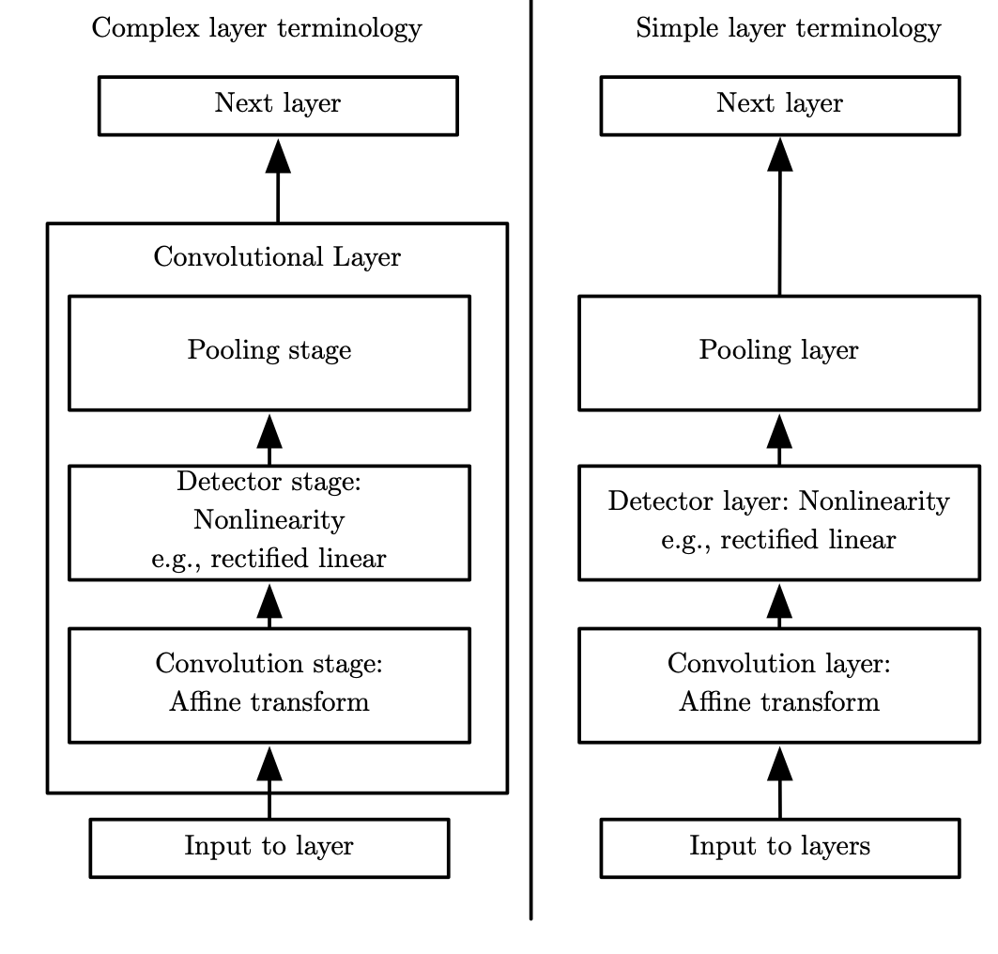

Slide 22
Why pooling?
Invariance:
Pooling helps to make the representation become approximately invariant to small translations of the input.
Invariance to translation means that if we translate the input by a small amount, the values of most of the pooled outputs do not change.
Invariance to local translation can be a very useful property if we care more about whether some feature is present than exactly where it is.
The use of pooling can be viewed as adding an infinitely strong prior that the function the layer learns must be invariant to small translations.
Efficiency:
Pooling units summarize detector units by reporting summary statistics for pooling regions spaced k pixels apart rather than 1 pixel apart.
This improves the computational efficiency of the network
improved statistical efficiency and reduced memory requirements for storing the parameters.

Slide 23
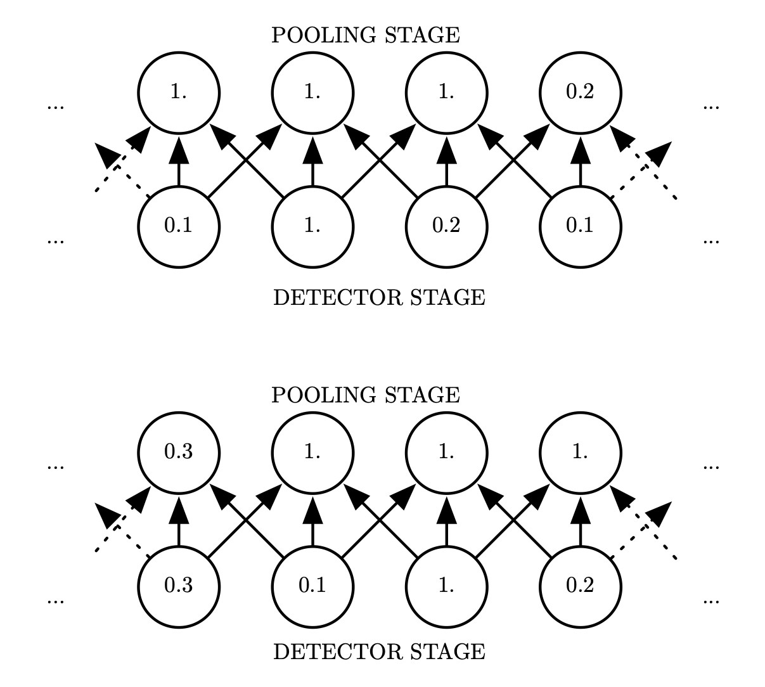
Max Pooling and Invariance to Translation
Stride = 1
Width = 3

Slide 24
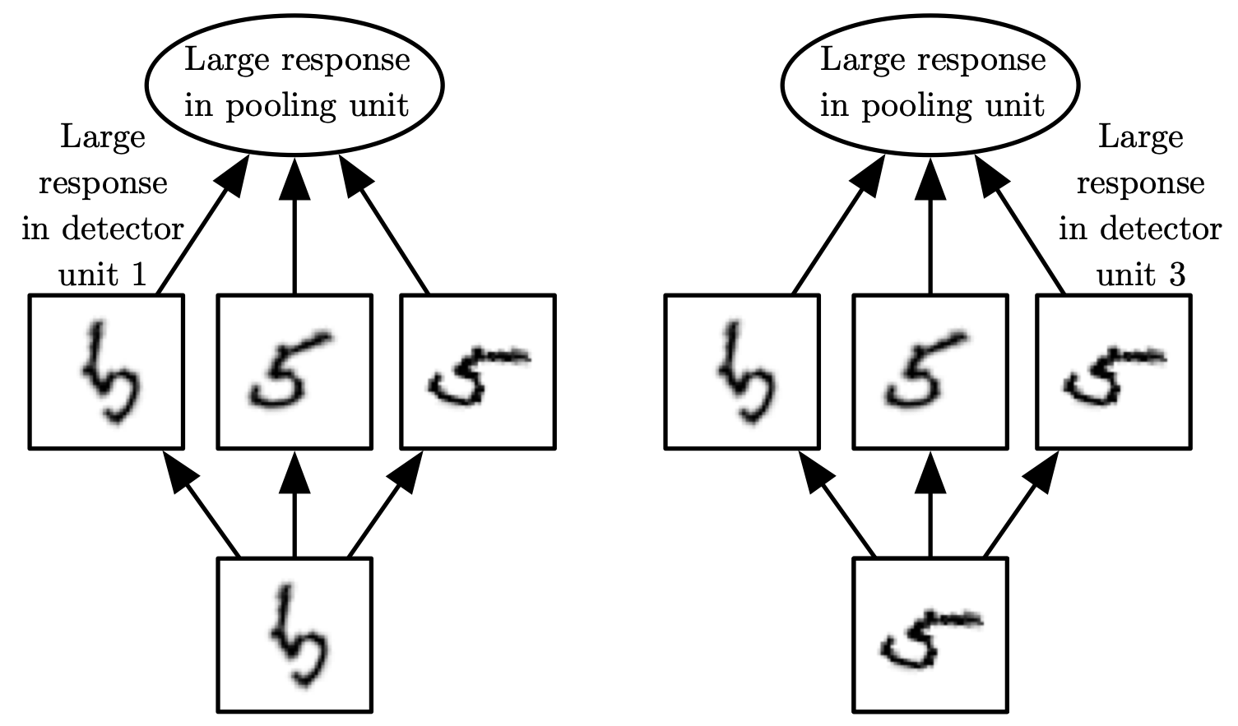
Cross-Channel Pooling and Invariance to Learned Transformations

Slide 25
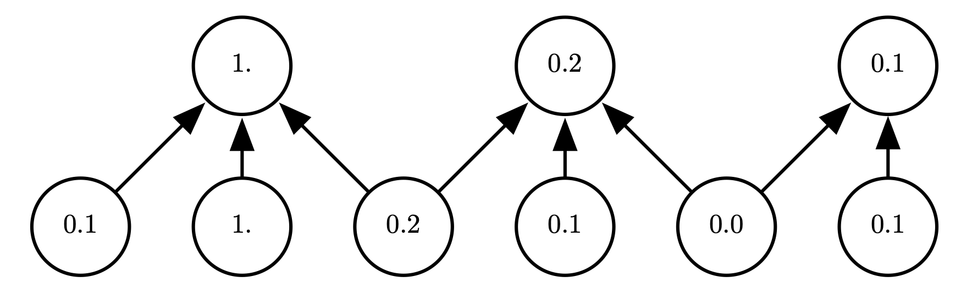
Pooling with Downsampling
Stride = 2
Width = 3

Slide 26
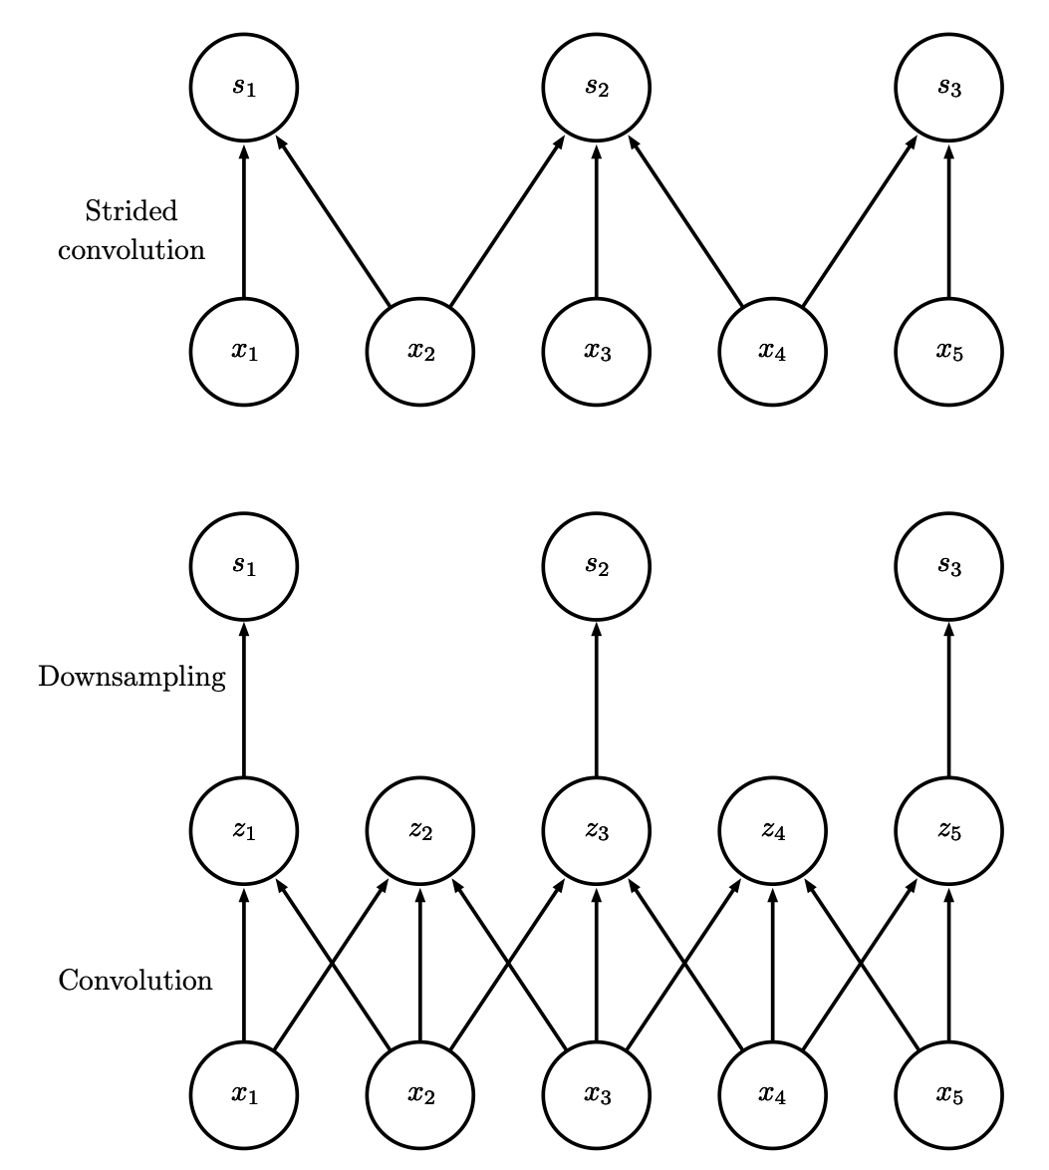
Convolution with Stride
Stride of 2

Slide 27
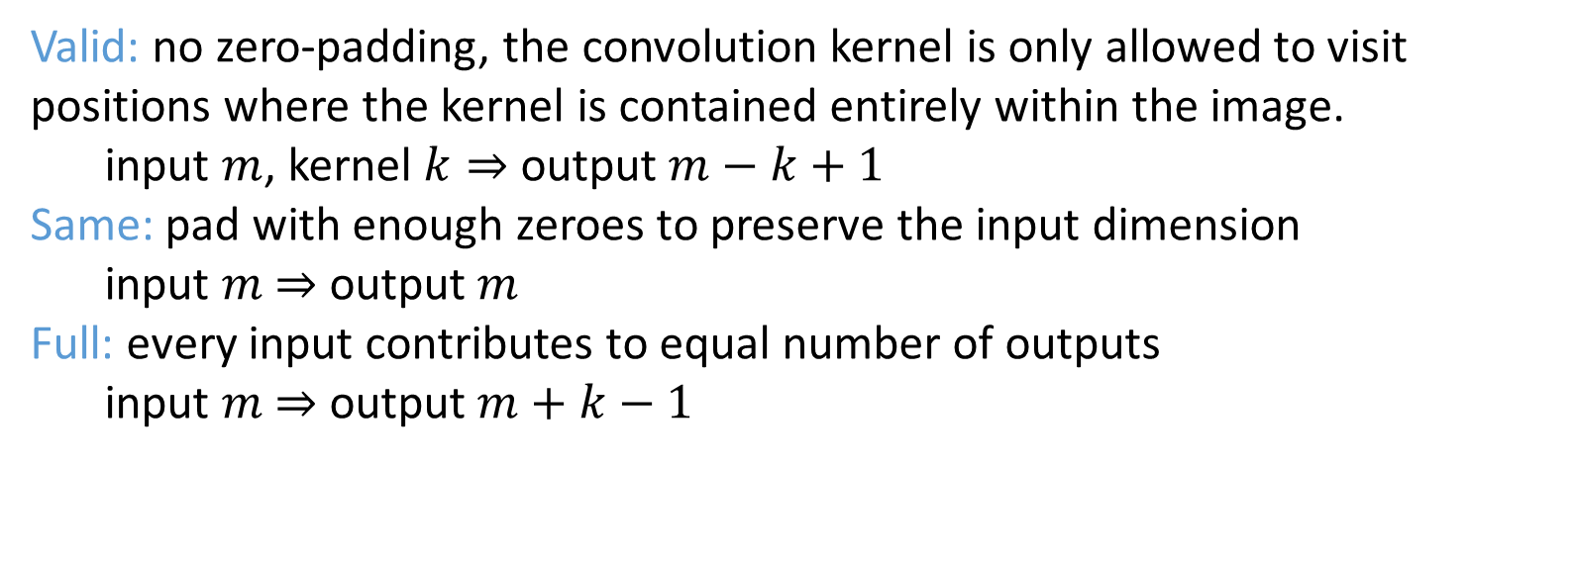
Zero padding
Valid: no zero-padding, the convolution kernel is only allowed to visit positions where the kernel is contained entirely within the image.
input $m$, kernel $k⇒$ output $m−k+1$
Same: pad with enough zeroes to preserve the input dimension
input $m$ $⇒$ output $m$
Full: every input contributes to equal number of outputs
input $m$ $⇒$ output $m+k−1$

Slide 28
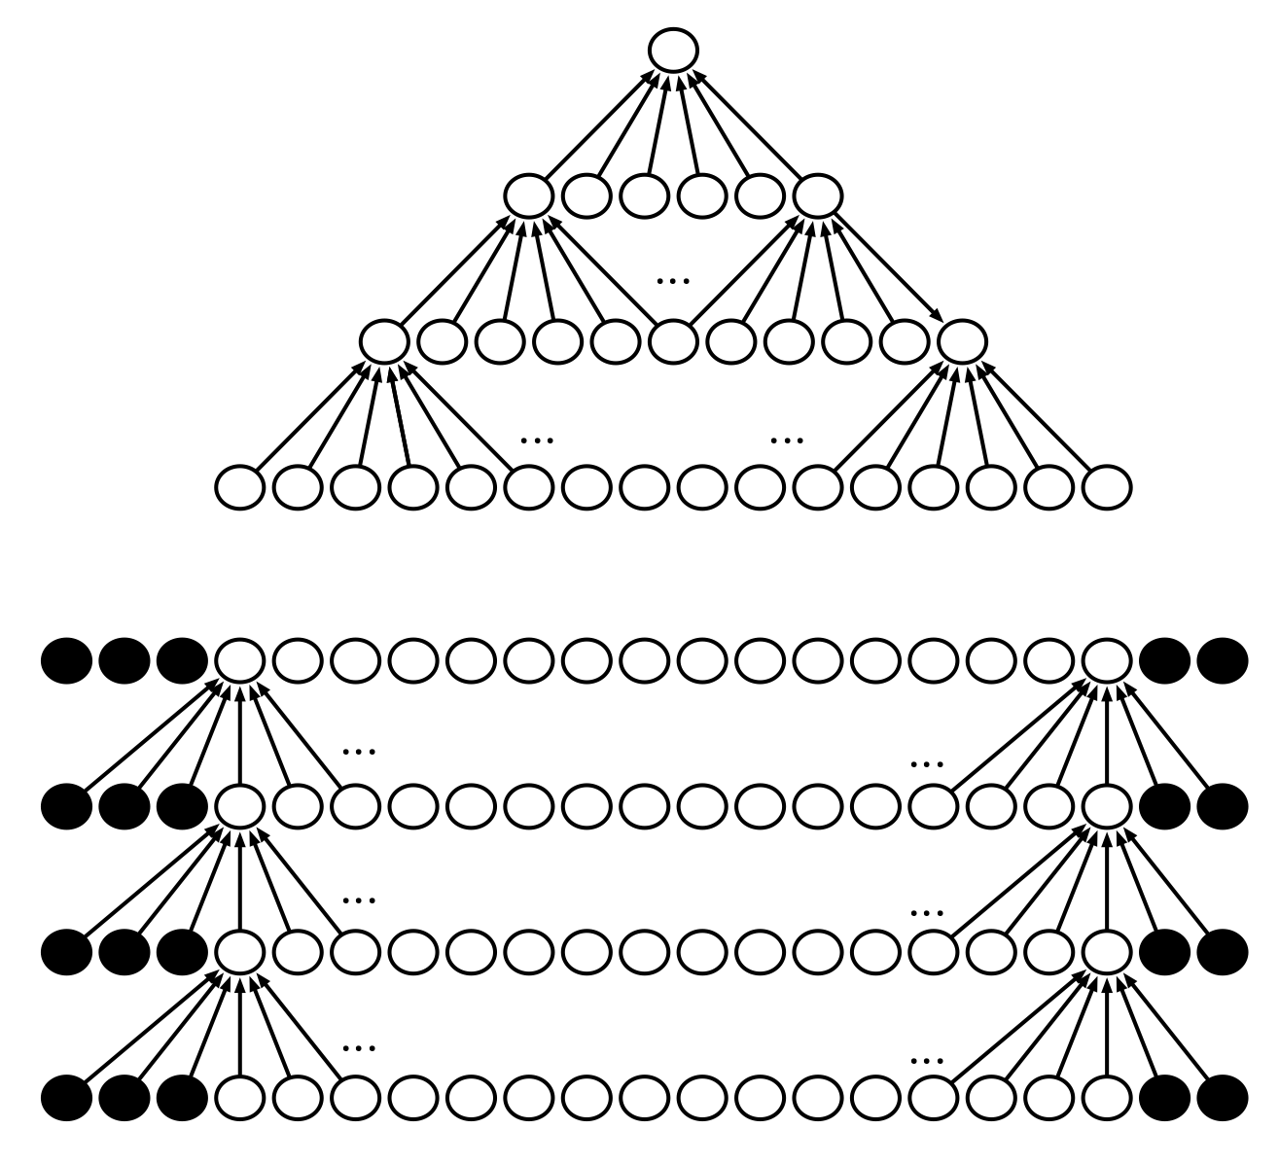
Without zero Padding (valid)
Without zero
Padding (valid)
With zero
Padding (same)

